Slide 1
Employee Salary Prediction
IBM INTERSHIP PROJECT
Presented By:
1. SIDDHARTH MALI GANPAT UNIVERSITY

Slide 2
OUTLINE
Problem Statement (Should not include solution)
System Development Approach (Technology Used)
Algorithm & Deployment (Step by Step Procedure)
Result
Conclusion
Future Scope(Optonal)
References

Slide 3
Problem Statement
In many industries, predicting the right salary for a position can be challenging due to varying qualifications, roles, and experience.
This project aims to build a machine learning model that can predict an employee's salary based on relevant features like experience, education level, and job role.

Slide 4
System Approach
The Load, clean, and encode data → Train Linear & Polynomial Regression models → Evaluate performance and predict salaries
System requirements : Python, Jupyter Notebook, Pandas, Scikit-learn
Environment: Runs on local machine or Google Colab

Slide 5
Algorithm & Deployment
🤖 Algorithm & Deployment
Algorithm:
Used Linear Regression and Polynomial Regression to model salary prediction.
Compared models using R² score and Mean Squared Error (MSE).
Deployment:
Can be deployed using Flask or Streamlit for web access.
Ideal for integration with HR portals or internal tools.

Slide 6
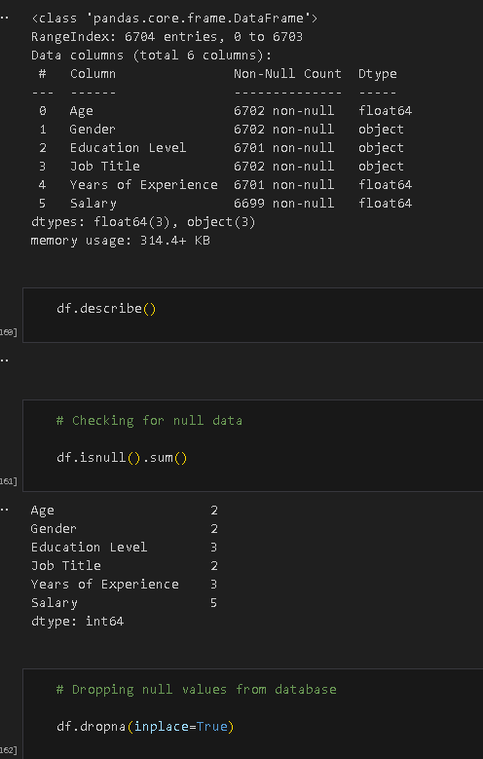
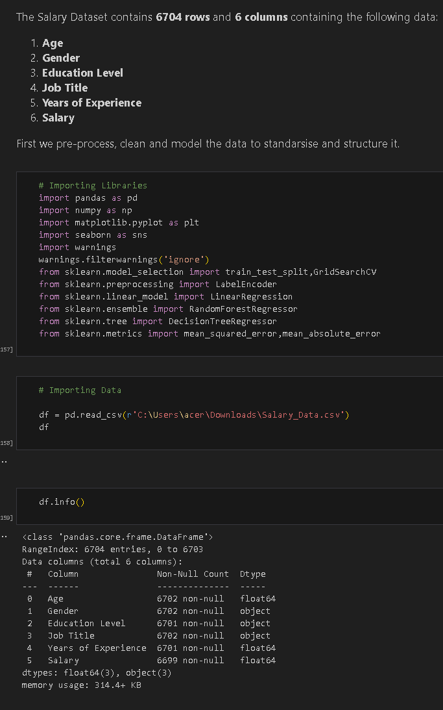
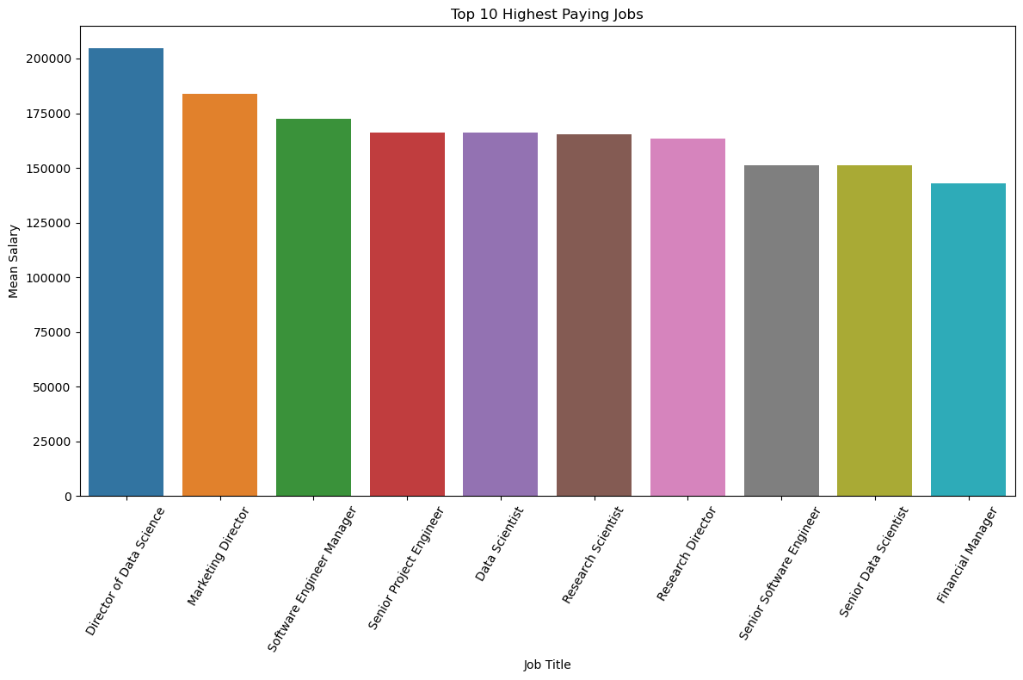
Result
Attach your Github link
https://github.com/

Slide 7
Conclusion
The Employee Salary Prediction system provides a data-driven approach to estimating salaries based on experience and position.
By using machine learning algorithms, it improves decision-making for HR professionals.
The model is scalable and adaptable, making it valuable for real-world deployment and future enhancements.

Slide 8
Future scope(Optional)
Personalized Assistance: Implement machine learning algorithms to offer personalized recommendations and adaptive guidance. Multilingual Support: Integrate language translation capabilities to cater to diverse applicant demographics. Enhanced Features: Incorporate virtual campus tours, interactive FAQs, and real-time application status updates.

Slide 9
References
IBM watsonx Assistant tutorial

Slide 10
THANK YOU

